Slide 1

P peline
The Data
Machine Learning IV: Big Data &
Integrating ML into Interactive Systems
© Jennifer Mankoff & Nikola Banovic
The Data Pipeline; HCII; Spring 2017
Slides modified & borrowed from Carolyn Rosé
Want to go deeper? http://see.stanford.edu/see/lecturelist.aspx?coll=348ca38a-3a6d-4052-937d-cb017338d7b1

Slide 2
Quick, Draw!
https://aiexperiments.withgoogle.com/quick-draw

Slide 3
Plan for today
Byte 4
Quiz
Talk about big data machine learning
Integrating ML into interactive systems

Slide 4
Quiz
4/6 Quiz
mayank

Slide 5
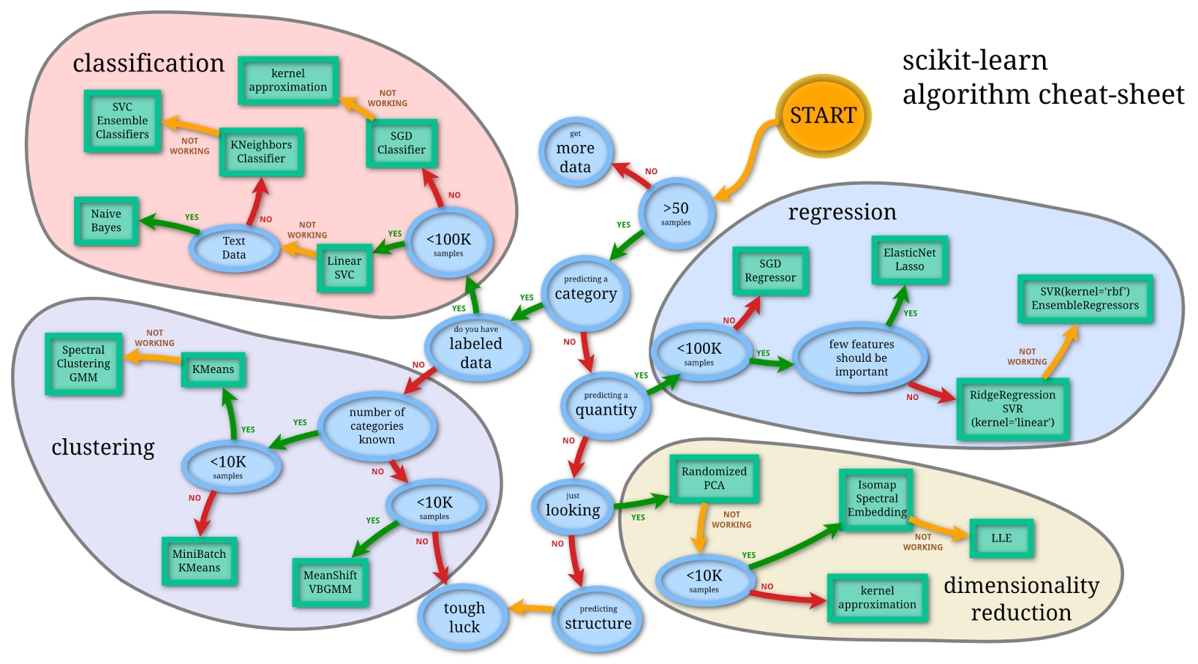
Selecting algorithms for Big Data
http://www.quora.com/What-are-the-advantages-of-different-classification-algorithms

Slide 6
Selecting algorithms for Big Data
http://www.quora.com/What-are-the-advantages-of-different-classification-algorithms

Slide 7
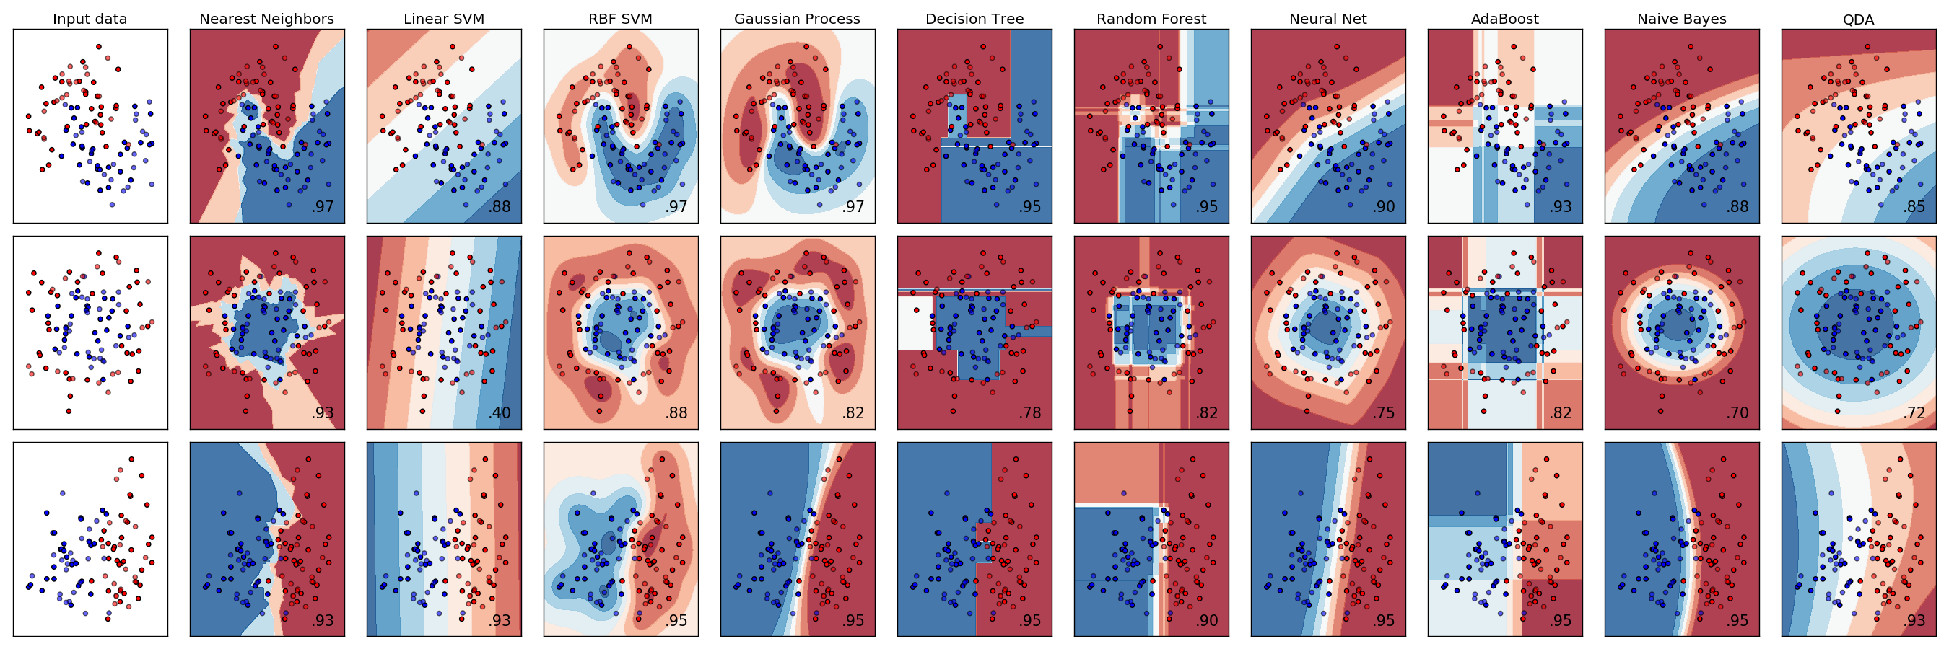
Selecting algorithms
http://scikit-learn.org/stable/auto_examples/classification/plot_classifier_comparison.html
Notes:
Which ones would work with big data?

Slide 8
Google BigQuery
“A fast, economical and fully managed data warehouse for large-scale data analytics.”

Slide 9
Google BigQuery
“A fast, economical and fully managed data warehouse for large-scale data analytics.”

Slide 10
Google BigQuery
“A fast, economical and fully managed data warehouse for large-scale data analytics.”

Slide 11
The Data Set
There are a number of public data sets on BigQuery. You can use any of them
We focus on the natality data set
https://cloud.google.com/bigquery/docs/dataset-natality
“All births registered in the 50 States, DC, and NYC from 1969 to 2008. The CDC receives these data as electronic files, prepared from individual records processed by each registration area…”
~22GB of data.

Slide 12
Example: Natality Data Set
Field Name | Type | Description
alcohol_use | BOOL | True if the mother used alcohol. Available starting 1989
apgar_1min | INT | Apgar scores measure the health of a newborn child on a scale from 0-10. Value after 1 minute. Available from 1978-2002.
apgar_5min | INT | Apgar scores measure the health of a newborn child on a scale from 0-10. Value after 5 minutes. Available from 1978-2002.
born_alive_alive | INT | Number of children previously born to the mother who are now living.
born_alive_dead | INT | Number of children previously born to the mother who are now dead.
…

Slide 13
Natality Data Set
…
Field Name | Type | Description
plurality | INT | How many children were born as a result of this pregnancy. twins=2, triplets=3, and so on.
state | STR | The two character postal code for the state. Entries after 2004 do not include this value.
wday | INT | Day of the week, where 1 is Sunday and 7 is Saturday.
weight_gain_pounds | FLOAT | Number of pounds gained by the mother during pregnancy.
weight_pounds | FLOAT | Weight of the child, in pounds.
year | INT | Four-digit year of the birth. Example: 1975.
https://cloud.google.com/bigquery/docs/dataset-natality
Notes:
Discuss how to pick appropriate features and talk about some of these and whether or not they are ok to use…

Slide 14
After applying logistic regression:
drinks_per_week : 10.4458435228
born_alive_alive : 5.10540437526
born_alive_dead : 0.201596177591
father_age : 158.603348865
mother_age : 145.833818566
weight_gain_pounds : 145.577879963
year : 9944.99904843
… [I had other features too in this]
accuracy : 0.91249999999999998
Notes:
Discuss year
Discuss variations among these features
Discuss accuracy …

Slide 15
Regression for big data
Batch mode : Gradient Descent
w_{j} = w_{i} - η Δ(w) over the entire data S
Difficult to parallelize

Slide 16
How do we handle big data
Batch mode : Gradient Descent
w_{j} = w_{i} - η Δ(w) over the entire data S
Incremental mode: stochastic gradient descent
w_{j} = w_{i} - η * approximation of Δ(w)

Slide 17
How do we handle big data
Batch mode : Gradient Descent
w_{j} = w_{i} - η Δ(w) over the entire data S
Incremental mode: stochastic gradient descent
w_{j} = w_{i} - η * approximation of Δ(w)
can approximate Batch Gradient Descent arbitrarily closely if η is small enough
supports online learning
easily parallelized
Not guaranteed to reach global minimum

Slide 18
Implementing Stochastic Gradient Descent with BigQuery
# a helper function for retrieving data from the database and putting it into # the right format for machine learning. def get_data(self, features, predict, prediction_test, filter=None, limit=_MAX_ROWS):
# need to retrieve data from bigquery query_string = self.make_query_string(features, predict, filter, limit)
…
# y are the labels -- the values we are predicting y = np.array(labels)
# X are the features -- the values we use to make the prediction X = np.array(data)
return X, y

Slide 19
get_data
# a helper function for retrieving data from the database and putting it into # the right format for machine learning. def get_data(self, features, predict, prediction_test, filter=None, limit=_MAX_ROWS):
# need to retrieve data from bigquery query_string = self.make_query_string(features, predict, filter, limit)
…
# y are the labels -- the values we are predicting y = np.array(labels)
# X are the features -- the values we use to make the prediction X = np.array(data)
return X, y
get_data returns two variables: A vector of labels, and an array of values.

Slide 20
get_data
get_data depends on make_query_string
# a helper function for retrieving data from the database and putting it into # the right format for machine learning. def get_data(self, features, predict, prediction_test, filter=None, limit=_MAX_ROWS):
# need to retrieve data from bigquery query_string = self.make_query_string(features, predict, filter, limit)
…
# y are the labels -- the values we are predicting y = np.array(labels)
# X are the features -- the values we use to make the prediction X = np.array(data)
return X, y

Slide 21
get_data
get_data depends on make_query_string
# a helper function for retrieving data from the database and putting it into # the right format for machine learning. def get_data(self, features, predict, prediction_test, filter=None, limit=_MAX_ROWS):
# need to retrieve data from bigquery query_string = self.make_query_string(features, predict, filter, limit)
…
# y are the labels -- the values we are predicting y = np.array(labels)
# X are the features -- the values we use to make the prediction X = np.array(data)
return X, y
make_query_string constructs a query string out of the features

Slide 22
get_data
get_data depends on make_query_string
# a helper function for retrieving data from the database and putting it into # the right format for machine learning. def get_data(self, features, predict, prediction_test, filter=None, limit=_MAX_ROWS):
# need to retrieve data from bigquery query_string = self.make_query_string(features, predict, filter, limit)
…
# y are the labels -- the values we are predicting y = np.array(labels)
# X are the features -- the values we use to make the prediction X = np.array(data)
return X, y
make_query_string constructs a query string out of the features, class to be predicted

Slide 23
get_data
get_data depends on make_query_string
# a helper function for retrieving data from the database and putting it into # the right format for machine learning. def get_data(self, features, predict, prediction_test, filter=None, limit=_MAX_ROWS):
# need to retrieve data from bigquery query_string = self.make_query_string(features, predict, filter, limit)
…
# y are the labels -- the values we are predicting y = np.array(labels)
# X are the features -- the values we use to make the prediction X = np.array(data)
return X, y
make_query_string constructs a query string out of the features, class to be predicted, and a filter (for things unwanted)

Slide 24
get_data
get_data depends on make_query_string
# a helper function for retrieving data from the database and putting it into # the right format for machine learning. def get_data(self, features, predict, prediction_test, filter=None, limit=_MAX_ROWS):
# need to retrieve data from bigquery query_string = self.make_query_string(features, predict, filter, limit)
…
# y are the labels -- the values we are predicting y = np.array(labels)
# X are the features -- the values we use to make the prediction X = np.array(data)
return X, y
make_query_string constructs a query string out of the features, class to be predicted, and a filter (for things unwanted), limited to [limit] rows of results.

Slide 25
get_data
get_data depends on make_query_string
# a helper function for retrieving data from the database and putting it into # the right format for machine learning. def get_data(self, features, predict, prediction_test, filter=None, limit=_MAX_ROWS):
# need to retrieve data from bigquery query_string = self.make_query_string(features, predict, filter, limit)
…
# y are the labels -- the values we are predicting y = np.array(labels)
# X are the features -- the values we use to make the prediction X = np.array(data)
return X, y
An example filter is: "row_number % 2 = 1 AND apgar_1min < 7”
The first part of this specifies that we only use odd rows (for training) and the second part specifies the apgar values should only match one class.

Slide 26
Stochastic Version
def stochastic_gradient_descent(self, features, predict, prediction_test, zeros_string, ones_string, batch=10):
weights = np.random.random(len(features)+1)
# Technically, we would do only one x at each round, but we can load subsets of the data and do multiple rows at each round. _MAX_ROWS determines how much data is loaded at each iteration. for i in xrange(batch):
# get _MAX_ROWS of examples of bad births and good births (equal amounts of each). This is so we have lots of examples of both types bad_births, bad_births_labels = self.get_data(features, predict, prediction_test, zeros_string) good_births, good_births_labels = self.get_data(features, predict, prediction_test, ones_string)
# combine them into one data set y_labels = np.concatenate([bad_births_labels, good_births_labels]) X = np.concatenate([bad_births, good_births])
# the resulting weights weights = self.gradient_descent(weights, X, y_labels)
model = lambda x: 1-self.loss_func(x, weights)<.5
return weights, model
These strings help specify details needed to make the right query on the database. We want an equal number of examples of each class for training.
We need new labels and values each time we loop. self.get_data retrieves data from big_query for us
Notes:
Note that this choice is arguable, since the data is skewed we may want to keep that in mind during testing…

Slide 27
Stochastic Version
def stochastic_gradient_descent(self, features, predict, prediction_test, zeros_string, ones_string, batch=10):
weights = np.random.random(len(features)+1)
# Technically, we would do only one x at each round, but we can load subsets of the data and do multiple rows at each round. _MAX_ROWS determines how much data is loaded at each iteration. for i in xrange(batch):
# get _MAX_ROWS of examples of bad births and good births (equal amounts of each). This is so we have lots of examples of both types bad_births, bad_births_labels = self.get_data(features, predict, prediction_test, zeros_string) good_births, good_births_labels = self.get_data(features, predict, prediction_test, ones_string)
# combine them into one data set y_labels = np.concatenate([bad_births_labels, good_births_labels]) X = np.concatenate([bad_births, good_births])
# the resulting weights weights = self.gradient_descent(weights, X, y_labels)
model = lambda x: 1-self.loss_func(x, weights)<.5
return weights, model
Note that most of the parameters to stochastic_gradient_descent are really there to support the call to get_data…

Slide 28
Stochastic Version
def stochastic_gradient_descent(self, features, predict, prediction_test, zeros_string, ones_string, batch=10):
weights = np.random.random(len(features)+1)
# Technically, we would do only one x at each round, but we can load subsets of the data and do multiple rows at each round. _MAX_ROWS determines how much data is loaded at each iteration. for i in xrange(batch):
# get _MAX_ROWS of examples of bad births and good births (equal amounts of each). This is so we have lots of examples of both types bad_births, bad_births_labels = self.get_data(features, predict, prediction_test, zeros_string) good_births, good_births_labels = self.get_data(features, predict, prediction_test, ones_string)
# combine them into one data set y_labels = np.concatenate([bad_births_labels, good_births_labels]) X = np.concatenate([bad_births, good_births])
# the resulting weights weights = self.gradient_descent(weights, X, y_labels)
model = lambda x: 1-self.loss_func(x, weights)<.5
return weights, model
Here we call good old regular gradient descent to produce a set of weights for the features

Slide 29
Stochastic Version
def stochastic_gradient_descent(self, features, predict, prediction_test, zeros_string, ones_string, batch=10):
weights = np.random.random(len(features)+1)
# Technically, we would do only one x at each round, but we can load subsets of the data and do multiple rows at each round. _MAX_ROWS determines how much data is loaded at each iteration. for i in xrange(batch):
# get _MAX_ROWS of examples of bad births and good births (equal amounts of each). This is so we have lots of examples of both types bad_births, bad_births_labels = self.get_data(features, predict, prediction_test, zeros_string) good_births, good_births_labels = self.get_data(features, predict, prediction_test, ones_string)
# combine them into one data set y_labels = np.concatenate([bad_births_labels, good_births_labels]) X = np.concatenate([bad_births, good_births])
# the resulting weights weights = self.gradient_descent(weights, X, y_labels)
model = lambda x: 1-self.loss_func(x, weights)<.5
return weights, model
Lastly we construct a function that can take an example and make a prediction from it
Notes:
(we return both of them)

Slide 30
Applying the model
weights, regression_model = self.stochastic_gradient_descent(features, predict, self.apgar_1min_test, zeros_string, ones_string)
# testing_X is the data we will use to make predictions, labels are the ground truth (correct) y values. The test makes sure we are getting data for which the row numbers are even) testing_X, labels = self.get_data(features, predict, self.apgar_1min_test, filter="row_number % 2 = 0", limit=100)
# apply_model can apply any model (a model is just a function that can predict a value). it returns an accuracy
regression_accuracy = self.apply_model(regression_model, testing_X, labels)
Call stochastic_gradient_descent to train the model. Recall that it returns a function (the model)

Slide 31
Applying the model
weights, regression_model = self.stochastic_gradient_descent(features, predict, self.apgar_1min_test, zeros_string, ones_string)
# testing_X is the data we will use to make predictions, labels are the ground truth (correct) y values. The test makes sure we are getting data for which the row numbers are even) testing_X, labels = self.get_data(features, predict, self.apgar_1min_test, filter="row_number % 2 = 0", limit=100)
# apply_model can apply any model (a model is just a function that can predict a value). it returns an accuracy
regression_accuracy = self.apply_model(regression_model, testing_X, labels)
Here we need to cerate a test set. We use the even row numbers for our filter
Notes:
this is the half of our data we will use for testing, odd numbers are reserved for training)

Slide 32
Applying the model
weights, regression_model = self.stochastic_gradient_descent(features, predict, self.apgar_1min_test, zeros_string, ones_string)
# testing_X is the data we will use to make predictions, labels are the ground truth (correct) y values. The test makes sure we are getting data for which the row numbers are even) testing_X, labels = self.get_data(features, predict, self.apgar_1min_test, filter="row_number % 2 = 0", limit=100)
# apply_model can apply any model (a model is just a function that can predict a value). it returns an accuracy
regression_accuracy = self.apply_model(regression_model, testing_X, labels)
Here we apply the model to the test set using apply_model, which simply applies the model to each row in testing_X and then calculates accuracy

Slide 33
What you need to do
weights, regression_model = self.stochastic_gradient_descent(features, predict, self.apgar_1min_test, zeros_string, ones_string)
# testing_X is the data we will use to make predictions, labels are the ground truth (correct) y values. The test makes sure we are getting data for which the row numbers are even) testing_X, labels = self.get_data(features, predict, self.apgar_1min_test, filter="row_number % 2 = 0", limit=100)
# apply_model can apply any model (a model is just a function that can predict a value). it returns an accuracy
regression_accuracy = self.apply_model(regression_model, testing_X, labels)
1) You will need to update apply_model to also return a precision and recall score.

Slide 34
What you need to do
weights, regression_model = self.stochastic_gradient_descent(features, predict, self.apgar_1min_test, zeros_string, ones_string)
# testing_X is the data we will use to make predictions, labels are the ground truth (correct) y values. The test makes sure we are getting data for which the row numbers are even) testing_X, labels = self.get_data(features, predict, self.apgar_1min_test, filter="row_number % 2 = 0", limit=100)
# apply_model can apply any model (a model is just a function that can predict a value). it returns an accuracy
regression_accuracy = self.apply_model(regression_model, testing_X, labels)
# TODO: this is something you should implement yourself. zeror_model = self.zeror_train(features, predict, self.apgar_1min_test) zeror_accuracy = self.apply_model(zeror_model, testing_X, labels)
In addition, you should write a zeror_train function which returns a model that always predicts the majority class. This will require that you count how many rows have apgar_1min < 7 (vs >= 7) and then return a function that uses this information to make the same prediction no matter what features it is passed.

Slide 35
What you need to do
weights, regression_model = self.stochastic_gradient_descent(features, predict, self.apgar_1min_test, zeros_string, ones_string)
# testing_X is the data we will use to make predictions, labels are the ground truth (correct) y values. The test makes sure we are getting data for which the row numbers are even) testing_X, labels = self.get_data(features, predict, self.apgar_1min_test, filter="row_number % 2 = 0", limit=100)
# apply_model can apply any model (a model is just a function that can predict a value). it returns an accuracy
regression_accuracy = self.apply_model(regression_model, testing_X, labels)
# TODO: this is something you should implement yourself. zeror_model = self.zeror_train(features, predict, self.apgar_1min_test) zeror_accuracy = self.apply_model(zeror_model, testing_X, labels)
If you do that correctly, apply_model will just work for this model as it does for the regression model. Then you can compare the accuracies…

Slide 36
What you need to do
weights, regression_model = self.stochastic_gradient_descent(features, predict, self.apgar_1min_test, zeros_string, ones_string)
# testing_X is the data we will use to make predictions, labels are the ground truth (correct) y values. The test makes sure we are getting data for which the row numbers are even) testing_X, labels = self.get_data(features, predict, self.apgar_1min_test, filter="row_number % 2 = 0", limit=100)
# apply_model can apply any model (a model is just a function that can predict a value). it returns an accuracy
regression_accuracy = self.apply_model(regression_model, testing_X, labels)
# TODO: this is something you should implement yourself. zeror_model = self.zeror_train(features, predict, self.apgar_1min_test) zeror_accuracy = self.apply_model(zeror_model, testing_X, labels)
If you do that correctly, apply_model will just work for this model as it does for the regression model. Then you can compare the accuracies…

Slide 37
You do not have to implement it yourself!
sklearn.linear_model.SGDClassifier
Vowpal-Wabbit

Slide 38
Integrating ML into Interactive Systems
Notes:
What does it mean to integrate ML?

Slide 39
Integrating ML into Interactive Systems
Real-time Classification
Prediction
Recommendation
Requires to have a trained model
Send unseen data to model for prediction
Notes:
What does it mean to integrate ML?

Slide 40
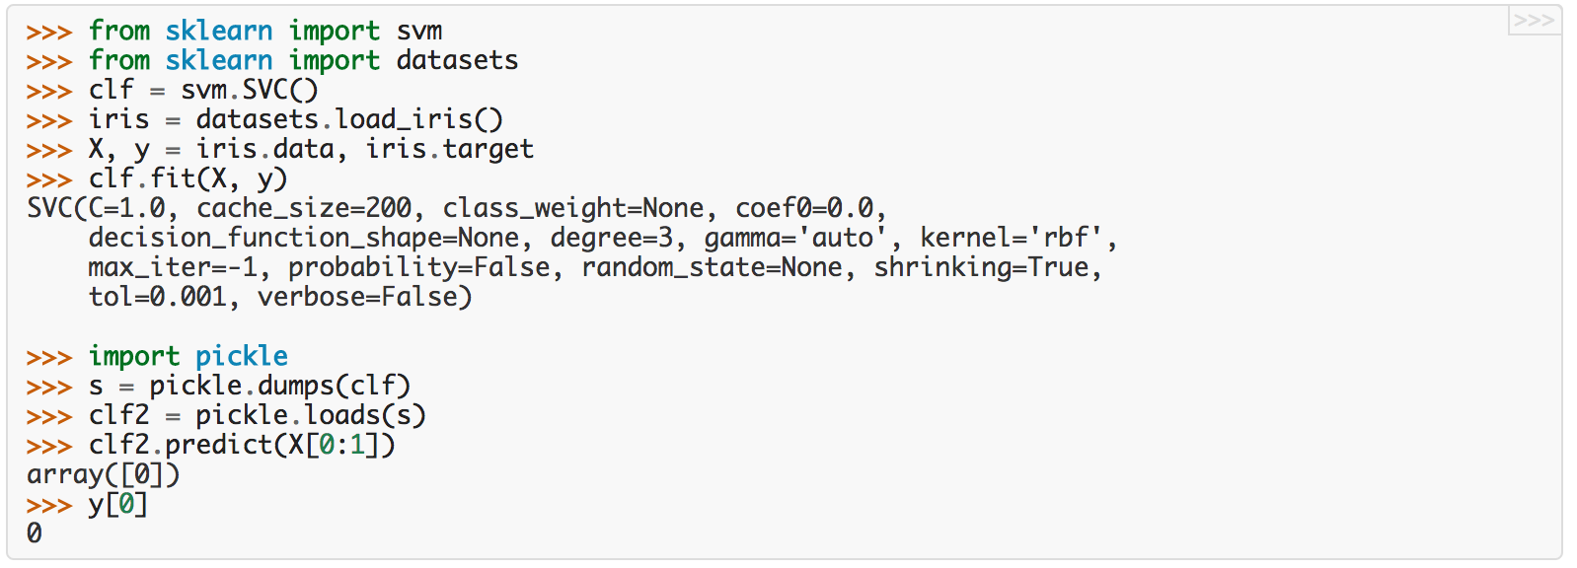
Integrating ML into Interactive Systems
Notes:
What does it mean to integrate ML?

Slide 41
Integrating ML into Interactive Systems
Notes:
What does it mean to integrate ML?

Slide 42
Integrating ML into Interactive Systems
Notes:
What does it mean to integrate ML?

Slide 43
Integrating ML into Interactive Systems
Notes:
What does it mean to integrate ML?

Slide 44
Integrating ML into Interactive Systems
Real-time Classification
Continued learning?

Slide 45
Integrating ML into Interactive Systems
Real-time Classification
Assessing performance over time

Slide 46
Integrating ML into Interactive Systems
Real-time Classification
Assessing performance over time
Continued learning:
Online learning
Active learning

Slide 47
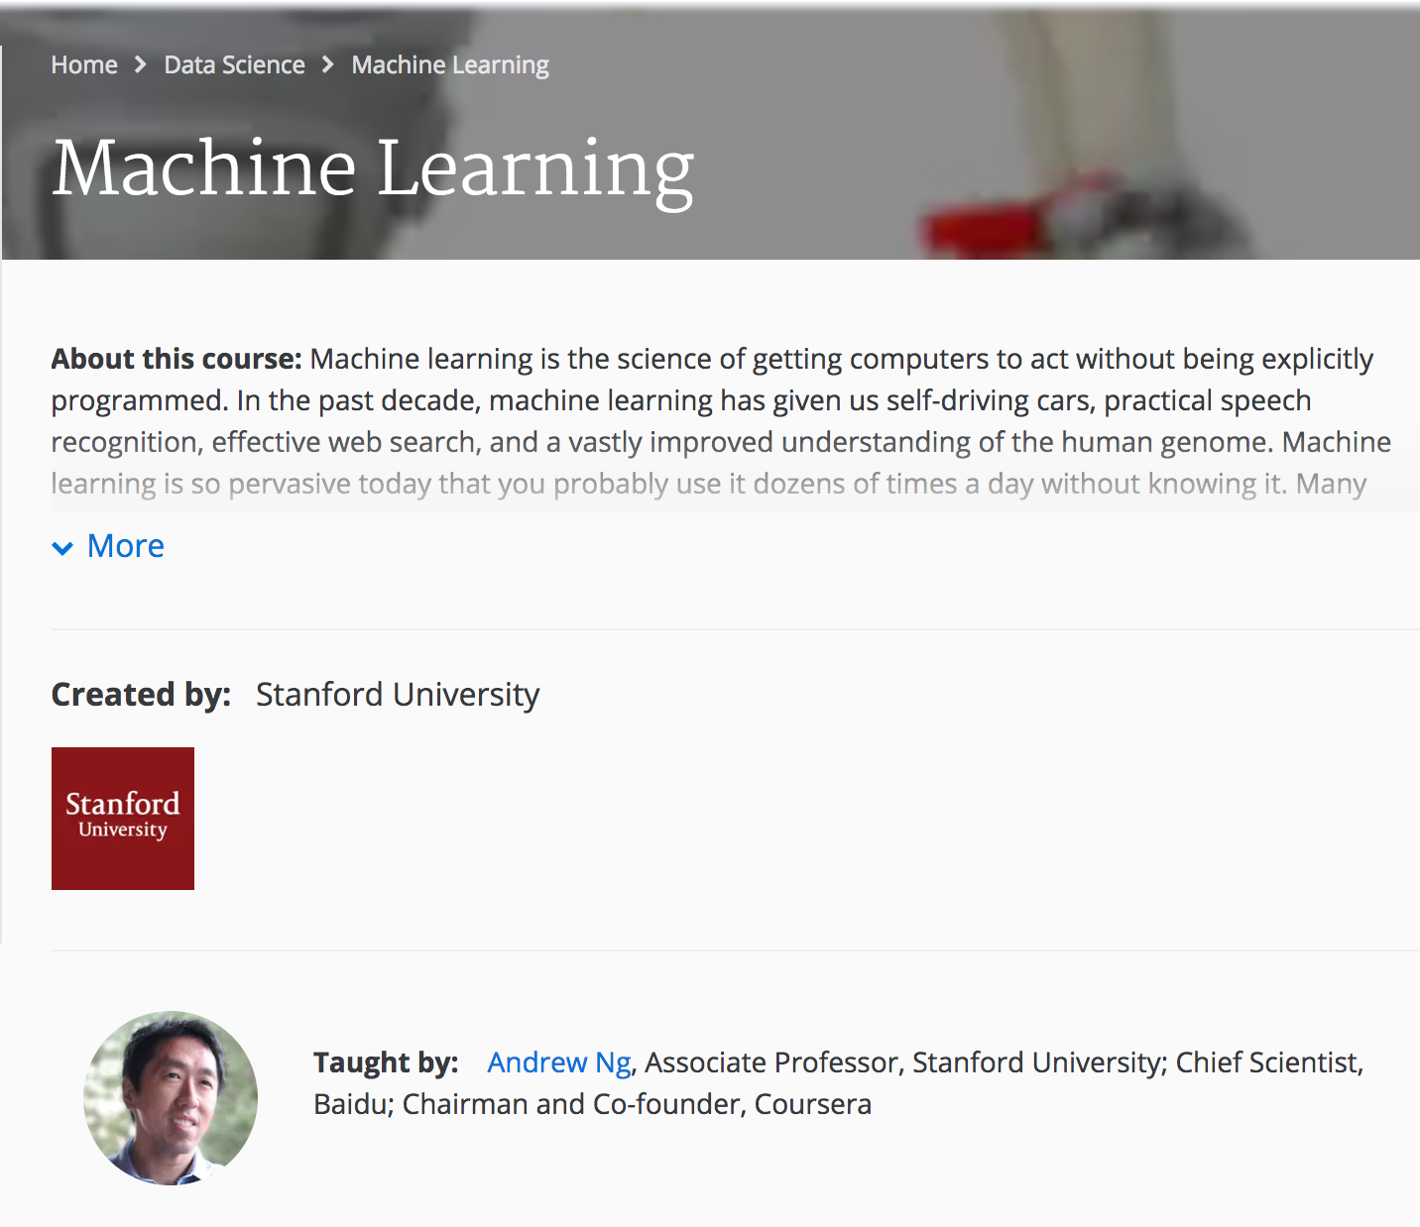
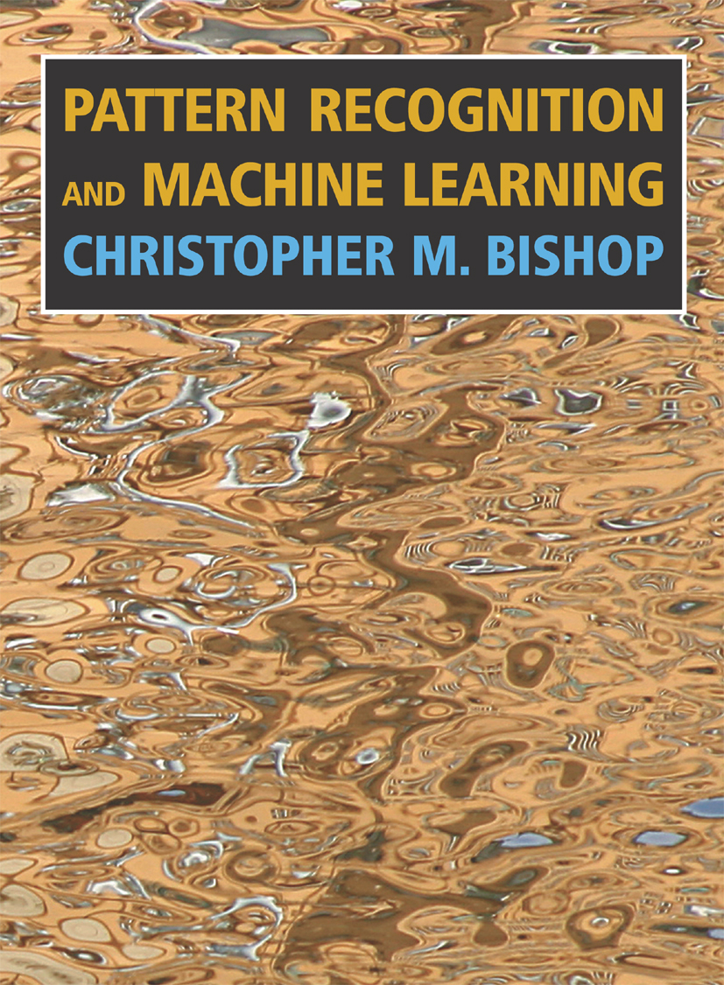
What’s next?

